Slide 1

Method-trace Analyser
Problem Statement - 2

Slide 2

Team Name
JavaMonks

Slide 3

Problem Statement: Method-trace Analyser
An application to assist the developers in debugging.
This problems is designed with a view to simplify the debugging and also provide clear graphical view of more than two log files.
This application has four major modules:
Code flow graphical view
Method time invocation
Method executed number of times
jStackTrace Anomalies
Each module will show the table as well as graph in order to make comparison more easier.

Slide 4
Role of each Team Member
Manjot Singh Sidhu
Christ Deemed to be University, Bengaluru (BTech CS Semester 1st )
Harsimran Kaur Sidhu
REVA University, Bengaluru (MCA Semester 5th )
UI/UX Design and Development
Documentation, PowerPoint Presentation
Solution Architecture, Design and Development
Project Lead
Testing

Slide 5
Tools/Platform/APIs used
Dependencies/APIs:
org.apache.commons (commons.io) used in converting files to string
com.github.vlsi.mxgraph (jgraphx) for rendering codeFlow
org.jfree (jfreechart) for rendering graphs for analysed tables
org.netbeans.external (AbsoluteLayout) for GUI
Tools/Platforms:
Windows, LINUX
OpenJDK 8
NetBeans IDE 8.2
Apache Maven 3.39
JAVA Swing API for GUI rendering

Slide 6
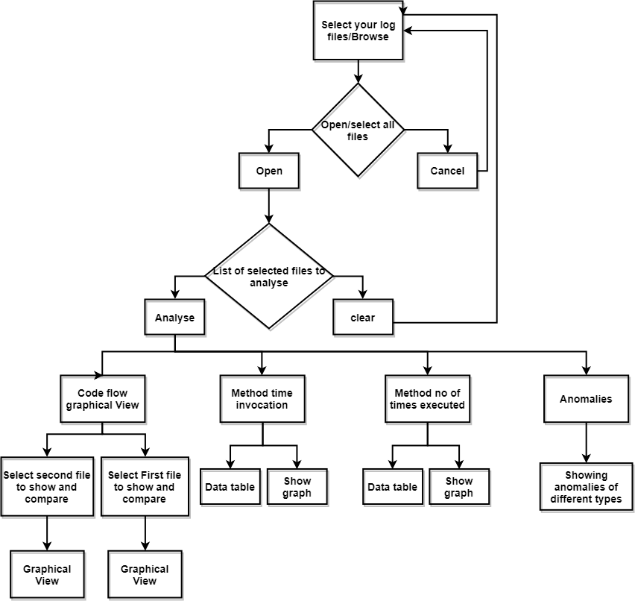
Process Flow Diagram

Slide 7
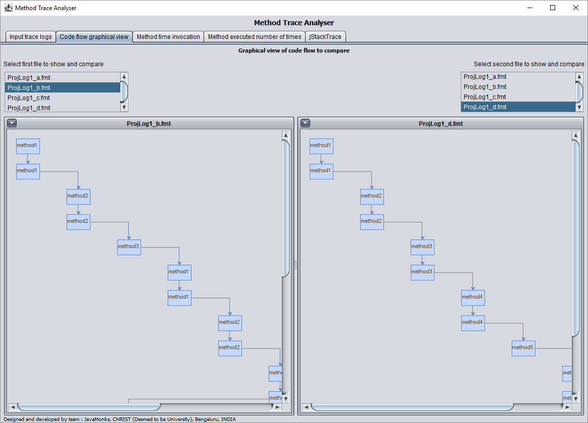
Screenshot of Solution

Slide 8
Functional Requirements
HARDWARE REQUIREMENTS
Same as Standard OpenJDK 8 system requirements:
Specified in web link below:
https://java.com/en/download/help/sysreq.xml
Minimum Requirement:
RAM: 128 MB
Disk Space: 100 MB
SOFTWARE REQUIREMENTS
Operating system as per OpenJDK 8
Link given below:
https://java.com/en/download/help/sysreq.xml
Develop & Tested on OS:
Windows 10, Ubuntu 16.04 LTE
Software used for development:
OpenJDK 8
NetBeans IDE 8.2
Apache Maven 3.39

Slide 9
Highlighting points
Below are some of the highlighted points which are specially taken care of during UI/UX:
User-friendly tab panel system
Easy comparison from side by side view
Detailed and scrollable Code flow with compare
Scalable and flexible graph with support of print and save
In-depth summary for long jStackTrace of methods

Slide 10





Thank you
Manjot Singh Sidhu
Harsimran Kaur Sidhu
9876471747
8283064757
Manjot.singh@btech.christuniversity.in
Harsimran.kaur.sidhu@outlook.com
Christ University, Bengaluru
REVA University, Bengaluru

